Slide 1
Kentucky Medical Cannabis: What Employers Need to Know Now
Dec. 12, 2024
Attorney-Client Privilege and Work Product

Slide 2
Lira A. Johnson
Partner
Louisville, KY
(502) 540 2328
lira.Johnson@dinsmore.com
Daniel S. Zinsmaster
Partner
Columbus, OH
(614) 628-6949
daniel.zinsmaster@dinsmore.com
Presenters

Slide 3
Disclaimer
The information provided in this webinar does not, and is not intended to, constitute legal advice; instead, all information, content, and materials provided are for general informational purposes only. Any references to other third-party information or websites are only for convenience and the contents are not endorsed by Dinsmore & Shohl LLP or the presenters. Participants should contact their attorney to obtain advice with respect to any particular legal matter. No participant should act or refrain from acting on the basis of information presented in this webinar without first seeking legal advice from counsel in the relevant jurisdiction. Only your individual attorney can provide assurances that the information presented and your interpretation of it is applicable or appropriate to your particular situation. Attending this webinar does not create an attorney-client relationship between the participants, Dinsmore & Shohl LLP, or the presenters.
The views expressed in this webinar are those of the individual authors writing in their individual capacities only and not a position adopted by Dinsmore & Shohl LLP as an organization. All liability with respect to actions taken or not taken based on the contents of this webinar are hereby expressly disclaimed. The content on this posting is provided "as is;" no representations are made that the content is error-free.

Slide 4
Federal Attitudes Soften
2009
Cole Memorandum
Directed U.S. Attorneys to utilize their resources and their discretion before prosecuting those using medical marijuana in compliance with respective state laws.
2014
Rohrabacher-Farr Amendment
Prohibits the Justice Department from spending funds to interfere with the implementation of state medical cannabis laws.
2014
Farm Bill
Defines hemp as any part of the cannabis plant, whether growing or not, with a Delta-9 THC concentration of not more than 0.3% on a dry weight basis.
Gave states discretion to adopt regulations governing hemp activity.
Hemp cultivation permitted at institutions of higher education or state agriculture departments for research purposes.
2018
Farm Bill
Expanded the definition of hemp to include derivatives, extracts, and cannabinoids.
Removed hemp from the Controlled Substances Act.
Permits interstate transportation of hemp.
Legalizes cultivation and commercialization of hemp.
“Hemp” defined as containing less than 0.3% Delta-9 THC.

Slide 5
Federal Attitudes
Cole Memorandum Rescinded
U.S. Attorney General Sessions issued a Marijuana Enforcement Memo in 2018, which reemphasized Congress’s position that marijuana “is a dangerous drug and that marijuana activity is a serious crime.”
More recent and current U.S. Attorney Generals have ostensibly supported the position advanced in the Cole Memorandum.
In 2022 President Biden announced an executive order to pardon all federal marijuana possession charges.

Slide 6
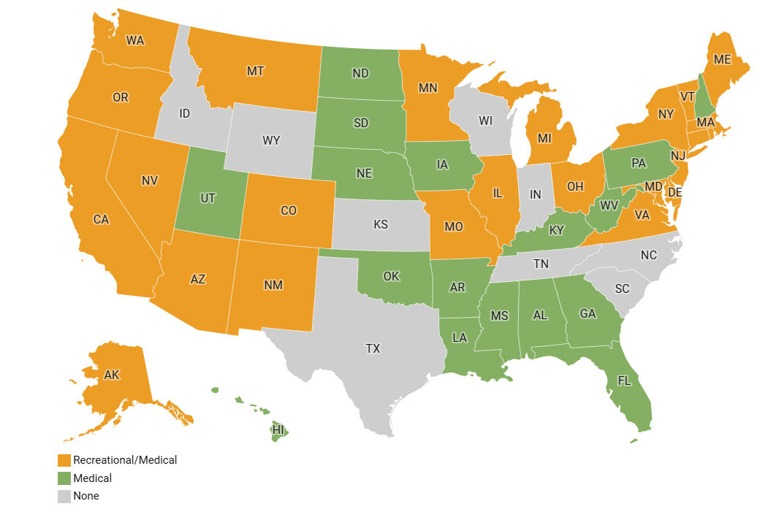
Current National Landscape
Legality by State
Legal for Recreational Use: 24
The District of Columbia, Guam, and the Northern Mariana Islands have also legalized recreational marijuana
Legal For Medical Use: 17 (plus those with Recreational Use)
Illegal: 9
November 2024 Election Update:
Nebraska voters approved medical use
Florida, North Dakota, and South Dakota voters rejected recreational use

Slide 7
Controlled Substance Act
Marijuana remains classified as Schedule I Controlled Substance, meaning that at the federal level, marijuana has no currently accepted medical use, lack of accepted safety for use under medical supervision, high potential for abuse.
Unlawful to manufacture, distribute, dispense, possess, or use marijuana.
No FDA approval.

Slide 8
Shifting Federal Landscape? HHS vs. DEA
On August 29, 2023, the US Department of Health and Human Services recommended to the Drug Enforcement Administration that marijuana be rescheduled from Schedule I to Schedule III under the Controlled Substances Act.
DEA is still reviewing HHS’s recommendation.
When considering whether to schedule or reschedule a controlled substance, DEA is bound by HHS’s recommendations on scientific and medical matters. However, DEA has also stated that it has “final authority to schedule, reschedule, or deschedule a drug under the Controlled Substances Act.”

Slide 9
Shifting Federal Landscape? HHS vs. DEA
On May 21, 2024, the DEA issued a notice of proposed rulemaking to change marijuana from Schedule I to Schedule III.
The comment period closes July 22, 2024.

Slide 10
Shifting Federal Landscape Cont’d
Some legal consequences if marijuana is moved from Schedule I to Schedule III:
Moving marijuana from Schedule I to Schedule III, without other legal changes, would not bring the state-legal medical or recreational marijuana industry into compliance with federal controlled substances law.
The key difference between placement in Schedule I and Schedule III is that substances in Schedule III have an accepted medical use and may lawfully be dispensed by prescription, while substances in Schedule I cannot.
Prescription drugs must be approved by the Food and Drug Administration (FDA).
Section 280E of the Internal Revenue Code – moving marijuana from Schedule I to Schedule III would allow marijuana businesses to deduct business expenses on federal tax filings.
Because U.S. banks are insured by the federal government, they cannot bank with businesses that grow and sell marijuana since it is illegal under federal law. Rescheduling would open the door for banks to work with marijuana businesses.

Slide 12
History in Kentucky
Hemp Pilot Program (2014)
Senate Bill 124 (2014)
Farm Bill (2018)
Governor Beshear’s Executive Order (2022)
Allowed individuals and their caregivers to bring and use medical marijuana into the state without facing legal consequences if they meet certain criteria.
Senate Bill 47 (2023)
Legalized medical cannabis starting in 2025.

Slide 13
November 15, 2022 Executive Order
Kentucky residents permitted to use medical marijuana in the commonwealth if they meet the following criteria:
The cannabis must be lawfully purchased in the U.S. from a state where the purchase is legal, and the receipt must be kept.
The amount purchased and used must not exceed eight (8) ounces.
Each person must have a certification from a licensed health care provider showing the person has been diagnosed with at least one of twenty-one (21) medical conditions.

Slide 14
Senate Bill 47
Signed into law on March 30, 2023.
Authorizes the Department of Health and Family Services to create a medical cannabis program in the Commonwealth of Kentucky.
Set to go into effect January 1, 2025.

Slide 15
Medical Cannabis Structure
Department of Health and Family Services
Board of Physicians and Advisors
State Board of Medical Licensure and Kentucky Board of Nursing
Dispensaries, Processors, Producers, Safety Compliance Facilities, Cultivators
Healthcare Practitioners
Patients / Caregivers

Slide 16
Businesses that Require a License
The Department of Health and Family Services will license the following:
Dispensaries
Cannabis Processors
Cannabis Producers (holding both cultivator and processor licenses)
Cannabis safety compliance facilities (Testing Laboratories)
Cannabis Cultivators:
Tier I not to exceed 2,500 square feet of canopy;
Tier II not to exceed 10,000 square feet of canopy;
Tier III not to exceed 25,000 square feet of canopy; and
Tier IV not to exceed 50,000 square feet of canopy.
Regulators have the right to deny an application for a cannabis business license for any reason deemed sufficient. If a license is denied the applicant has the right to seek an administrative hearing.

Slide 17
Cannabis Business Requirements
Obtain a license for each location it intends to operate.
There is a limit to one cultivation site and one processing facility per license.
All licenses are valid for one (1) year.
Pay all required licensure fees
All cannabis business licenses are subject to minimal performance standard established by the Cabinet for Health and Family Services.
Must conduct a criminal background check of every person that wishes to be an officer, board member, agent, volunteer, or employee.
Cannot be convicted of a disqualifying felony offense; and
Must be at least twenty-one (21) years of age.
Implement appropriate security measures to guard against theft and unauthorized entrance.
Demonstrate sufficient capital.
Sufficient capital means enough capital so you can establish your business and meet the needs for its type of cannabis business.
Only acquire, possess, cultivate, manufacture, deliver, transfer, supply, or dispense medicinal cannabis:
For distributing medical cannabis to cardholders, caregivers of cardholders, or visiting qualified patients.
From a cannabis business licensed under the laws of Kentucky.

Slide 18
How to Get a Medical Cannabis Card?

Slide 19
Obtaining a Registration Card
Steps to obtain a medical cannabis card:
​Visit an authorized medical cannabis practitioner.
Get a written certification from an authorized practitioner.
Once approved a written certification is valid for sixty (60) days and may be renewed by a practitioner up to three (3) times for sixty days each.
Apply online through the patient and caregiver registry portal provided by the Kentucky Medical Cannabis Program.
Upload required documentation.
Pay the application fee.
Note: After all renewals have been used, another in-person evaluation or a telehealth evaluation must be conducted before a new certification can be reissued.

Slide 20
Bona-Fide Practitioner-Patient Relationship
A treating or consulting relationship where the medicinal cannabis practitioner has:
Completed an initial in-person examination and assessment.
Consulted with the patient about the medical, therapeutic, and palliative benefits of medicinal cannabis.
Advised patient on the risk and side effects
Established an expectation that the practitioner will provide follow-up care.

Slide 21
Qualified Conditions
Any type or form of cancer
Chronic or Debilitating Pain
Epilepsy or any other type of seizure disorder
Multiple Sclerosis
Muscle Spasms
Spasticity
Chronic Nausea or Cyclical Vomiting
Post-traumatic stress disorder
Any other medical condition or disease for which the Kentucky Center for Cannabis finds appropriate

Slide 22
Who Else Can Buy Medicinal Cannabis?
Designated Caregivers
A person who is a resident of Kentucky that is at least twenty-one (21) years of age who has not been convicted of a disqualifying felony offense, has agreed to assist no more the three (3) registered qualified patients with the use of medicinal cannabis, and is register with the Cabinet.
Visiting Qualified Patients
A person who has registered as such through the cabinet or who possesses a valid out-of-state registry identification card and documentation of having been diagnosed with a qualifying medical condition (presumably by Kentucky’s definition).

Slide 23
Limitations
A patient may have up to a 30-day supply in their residence and a 10-day supply on their person. However practitioners may authorize a larger quantity if the practitioner reasonably believes a normal 30-day supply would be insufficient.
Medical cannabis that is not at one’s residence must be kept in the original container it was purchased in.
Cannabis cannot be within the driver’s reach while operating a motor vehicle.
Home cultivation is not allowed.
35% cap for raw cannabis, edibles cannot exceed 10 mg of THC per serving, and concentrates are capped at 70% THC.
Patients cannot do any task under the influence of cannabis that would be considered negligent.

Slide 24
Limitations (Cont.)
Physicians or advance practice nurses authorized to provide written certifications for the use of medicinal cannabis cannot have an ownership or investment interest in or compensation agreement with a licensed cannabis business.
Health insurance, workers compensation, and governmental medical assistance (Medicaid) do not need to reimburse for medical cannabis costs.
Employers may still choose to retain a drug-free workplaces.

Slide 25
Administrative Rules
On January 4, 2024 the Cabinet of Health and Family Services (“CHFS”) released proposed regulations governing the business aspects of growing, processing, and dispensing.
On March 14, CHFS issued proposed regulations on caregiver/patient interactions.
On April 18, 2024, CHFS issued “emergency” regulations, effective immediately, on licensure as a cannabis business.

Slide 26
Medical Cannabis and the Workplace

Slide 27
Lawful Employer Actions
Kentucky employers:
Can enter into contract that prohibits employees from using medical cannabis as a condition of employment
Can enforce the contract by discharging employee who violates it
New law states it does not create a claim under Kentucky law for “wrongful discharge or discrimination” by discharged employee

Slide 28
Lawful Employer Actions
Kentucky employers:
Can require all employees to follow a published drug testing policy
Can prohibit employees from working while impaired by medical cannabis
Can prohibit employees with medical cannabis card from certain work such as operating equipment, machinery or power tools that pose an “unreasonable safety risk”
Can use “good faith” to determine impairment of employee with a medical card

Slide 29
Lawful Employer Actions
Kentucky employers must:
Make a “good faith” determination of impairment at the workplace requires multiple steps:
Step 1: behavioral assessment – observing signs of impairment
Step 2: testing for marijuana using “established methods”
Step 3: if employer finds impairment using 1 & 2, employee has burden of refuting impairment

Slide 30
Unemployment Benefits
No right to Kentucky unemployment if employee discharged for:
Violating employment contract or workplace drug policy
By testing positive for controlled substance
By being “under the influence” at work

Slide 31
Take Action Now
Review, assess, and update workplace drug policy
Review and update written job descriptions
Review and assess terms of workers compensation insurance
Review and assess business contract terms

Slide 32
Overview of Accommodation Analysis
Document all inquiries and steps in accommodation process
Step One Determine if employee has a disability protected by the Americans with Disabilities Act (ADA) or Kentucky Civil Rights Act (KCRA)
Step Two Identify the essential functions of the job and any inherent risks
Step Three Use the interactive process to discuss proposed accommodation with employee
Step Four Determine that proposed accommodation does not violate state or federal law, contract terms, or insurance mandates
Step Five Assess whether employee, as accommodated, poses a risk of harm to self or others
Step Six Initiate a trial period for the accommodation, identifying the standards for measuring performance during that period
Step Seven Re-evaluate the success of the accommodation within a reasonable period (30, 60, 90 days)

Slide 33
Step One
Determine presence of disability protected by the ADA or KCRA
Epilepsy
Multiple Sclerosis
Post-traumatic stress disorder
Condition producing chronic severe pain

Slide 34
Step Two
Identify essential functions of the job and job risks
Jobs requiring drug-testing under federal law (49 CFR Part 40) include:
Commercial truck drivers
Pilots and aircraft maintenance personnel
Train engineers
Public transit drivers/operators
Certain employees working with oil and gas pipelines
School bus drivers

Slide 35
Step Three
Use the interactive process to discuss accommodation(s)
Implement written accommodation policy
Consistently require documentation establishing medical condition
Establish procedure for monitoring accommodation

Slide 36
Step Four
Determine a legal accommodation, if possible.

Slide 37
Step Five
Assess risks of employee harming self or others while using medical cannabis; plan to eliminate/mitigate risks.

Slide 38
Step Six
Initiate trial period for proposed accommodation
Identify the standards for measuring performance during that period
Re-evaluate the success of the accommodation within a reasonable period (30, 60, 90 days)

Slide 39
Step Seven
Monitor performance and safety during accommodation.

Slide 40
Employers and HIPAA
HIPAA Only Applies to “Covered Entities” & “Business Associates”
Healthcare Providers
Must follow HIPAA privacy and data security regulations.
May only disclose a patient’s protected health information with proper authorization or as otherwise allowed by law.
Health Plans
Must follow HIPAA privacy and data security regulations, even if it is an employer-sponsored, self-funded plan.
Healthcare Clearinghouses
Must follow HIPAA privacy and data security regulations, even if the employer is attempting to assist an employee in processing a claim for payment through the employer’s health plan.
Business Associates
Consultants for a Covered Entity, such as a hospital’s attorneys.

Slide 41
Employers and Confidentiality
Employers subject to ADA requirements for medical information
Maintain in secure (locked) file or password-protected, segregated electronic file
Do NOT store in personnel file
Limit access on a need-to-know basis to managers who must know about restrictions or accommodations
May disclose to first responders/first-aid providers if necessary for employee’s safety or emergency treatment
May disclose if required by law, such as in response to a subpoena

